Slide 1
FPGA-Based Health Monitoring System
Module : Advanced Hardware Engineering Lab – Winter Semester 2024/25
Presented by: Team 03 (Youssef Dokkar, Dapsara Kapuge, Kashif Raza)
Date: 14.01.2025

Slide 2
1. Introduction
Objective
Real-time, reliable health monitoring using FPGA technology.
Core Features
Nexys A7 FPGA as the processing unit.
PMOD sensors for temperature and motion detection.
Wireless data transmission via BLE module.
Application
Elderly care, fitness tracking, post-recovery monitoring.

Slide 3
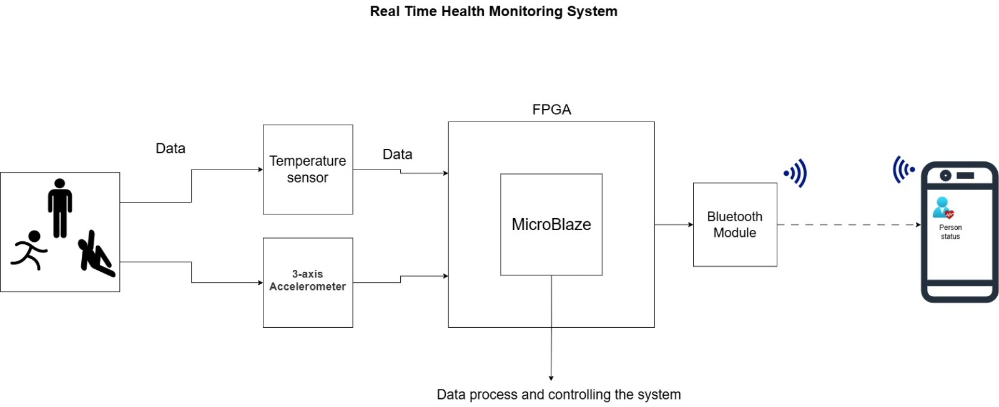
2. System Components
Hardware
Nexys A7 100T FPGA Board
Built-in TMP (Temperature Sensor)
PMOD ACL (Accelerometer Sensor)
PMOD BLE (Bluetooth Module)
Software
Vivado 2022.1
Vitis IDE

Slide 4
3. Requirement Diagram
UML Requirement Diagram for FPGA- Based Health Monitoring System
<<requirement>>
FPGA - Based Health Monitoring System
<<requirement>>
Hardware Requirements
<<requirement>>
Software Requirements
<<requirement>>
Central Processing
Nexys A7 100T FPGA Board
<<requirement>>
measure body temperature
Temperature Sensor
<<requirement>>
detecting motion and activity states
Accelerometer Sensor
<<requirement>>
wireless transmission of processed data
Bluetooth Sensor
<<requirement>>
Hardware Design
Vivado ML
<<requirement>>
Software Design
Vitis

Slide 5
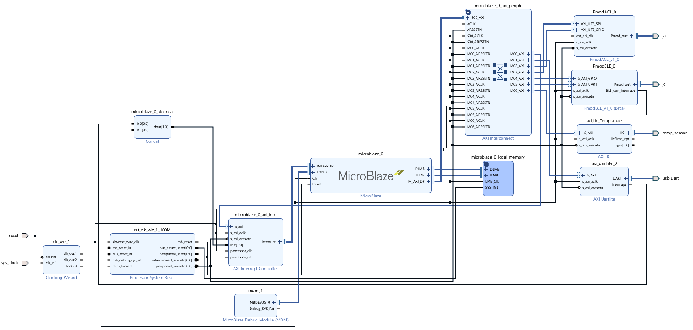
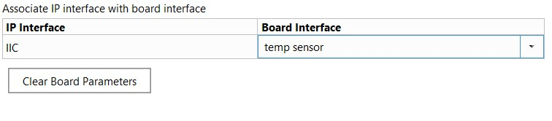
4. Implementation in Vivado
Block Design

Slide 6
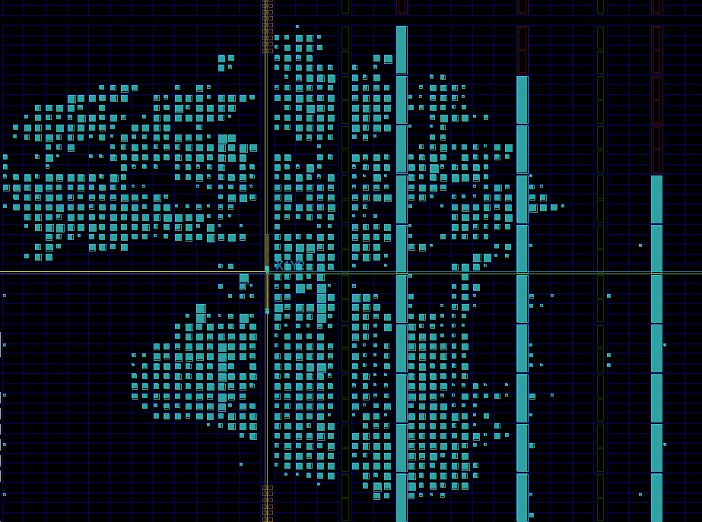
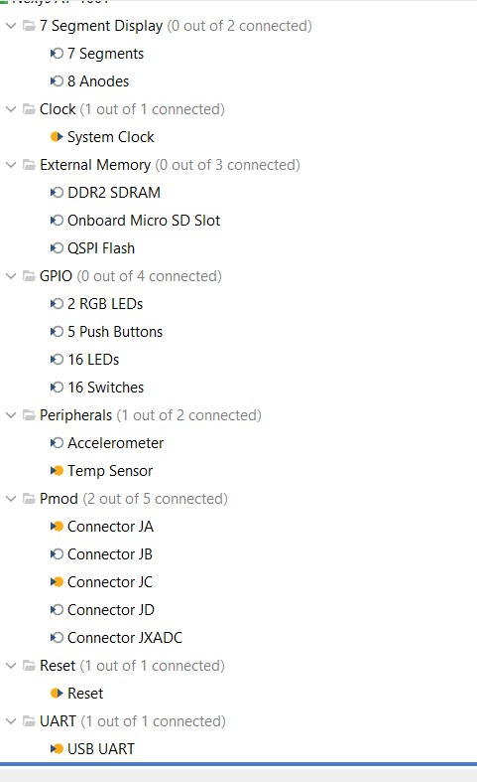
4. Implementation in Vivado
Board Connections and Bitstream generation

Slide 7
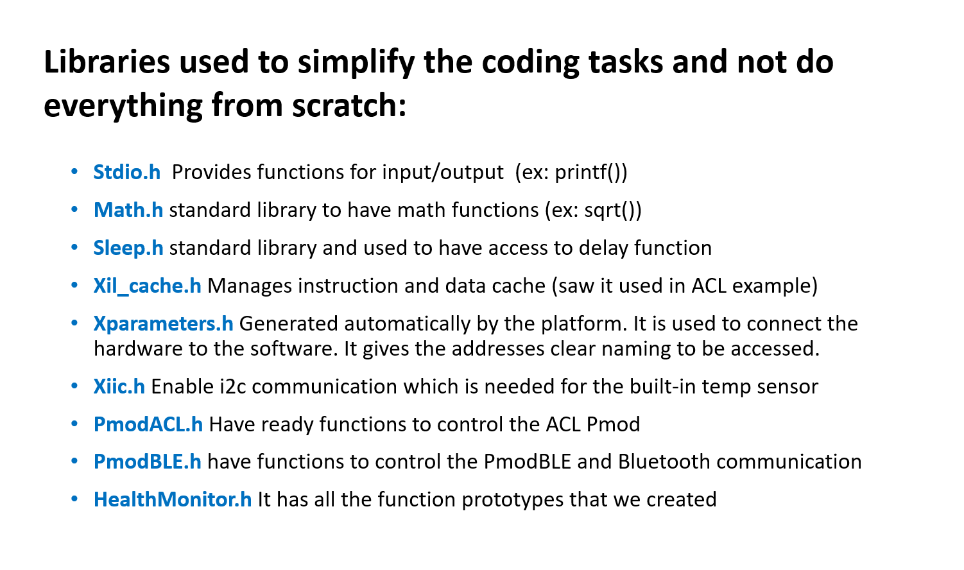
5. Implementation in Vitis
Libraries used to simplify the coding tasks and not do everything from scratch

Slide 8
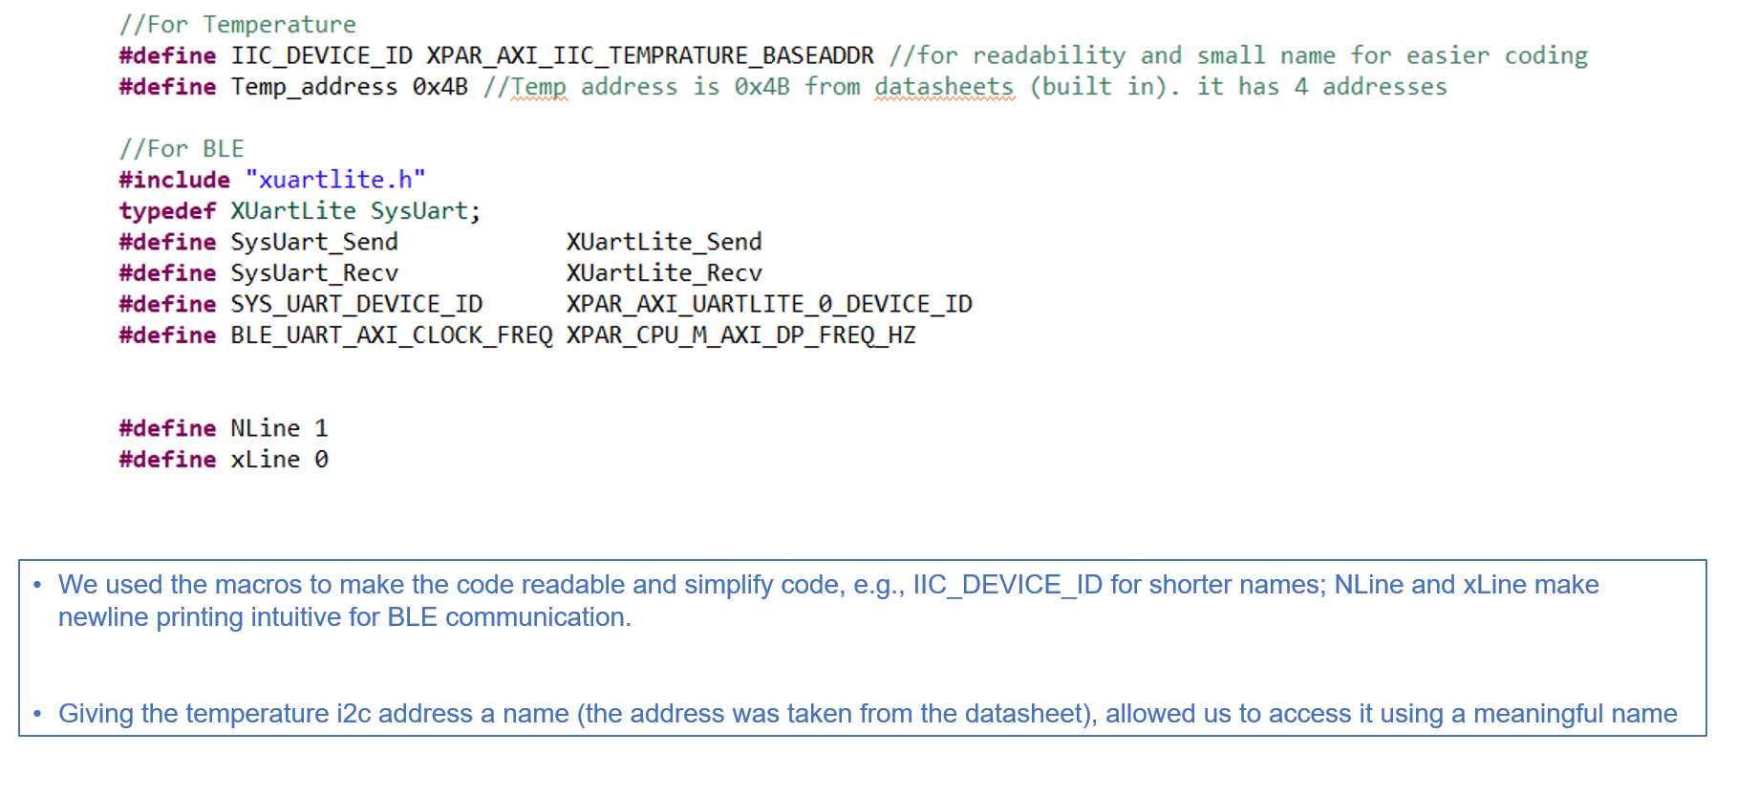
5. Implementation in Vitis
Macros

Slide 9
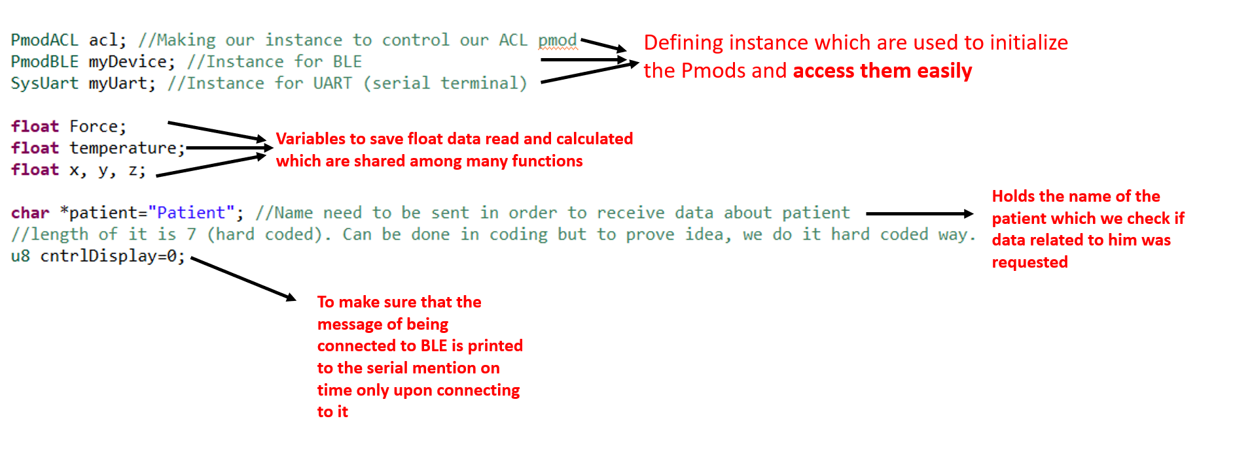
5. Implementation in Vitis
Global variables

Slide 10
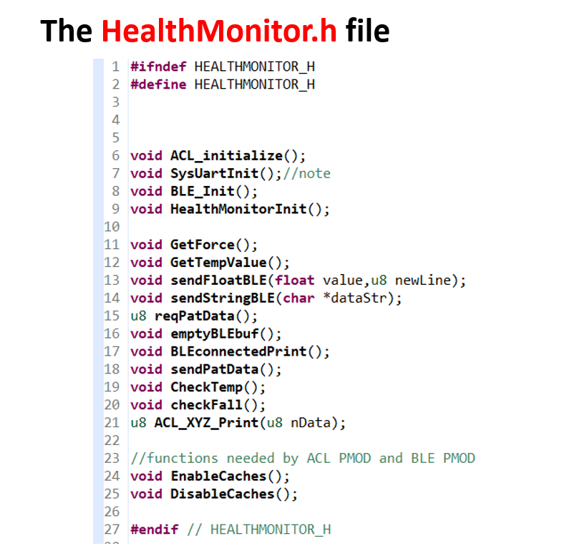
5. Implementation in Vitis
Used Functions and description

Slide 11
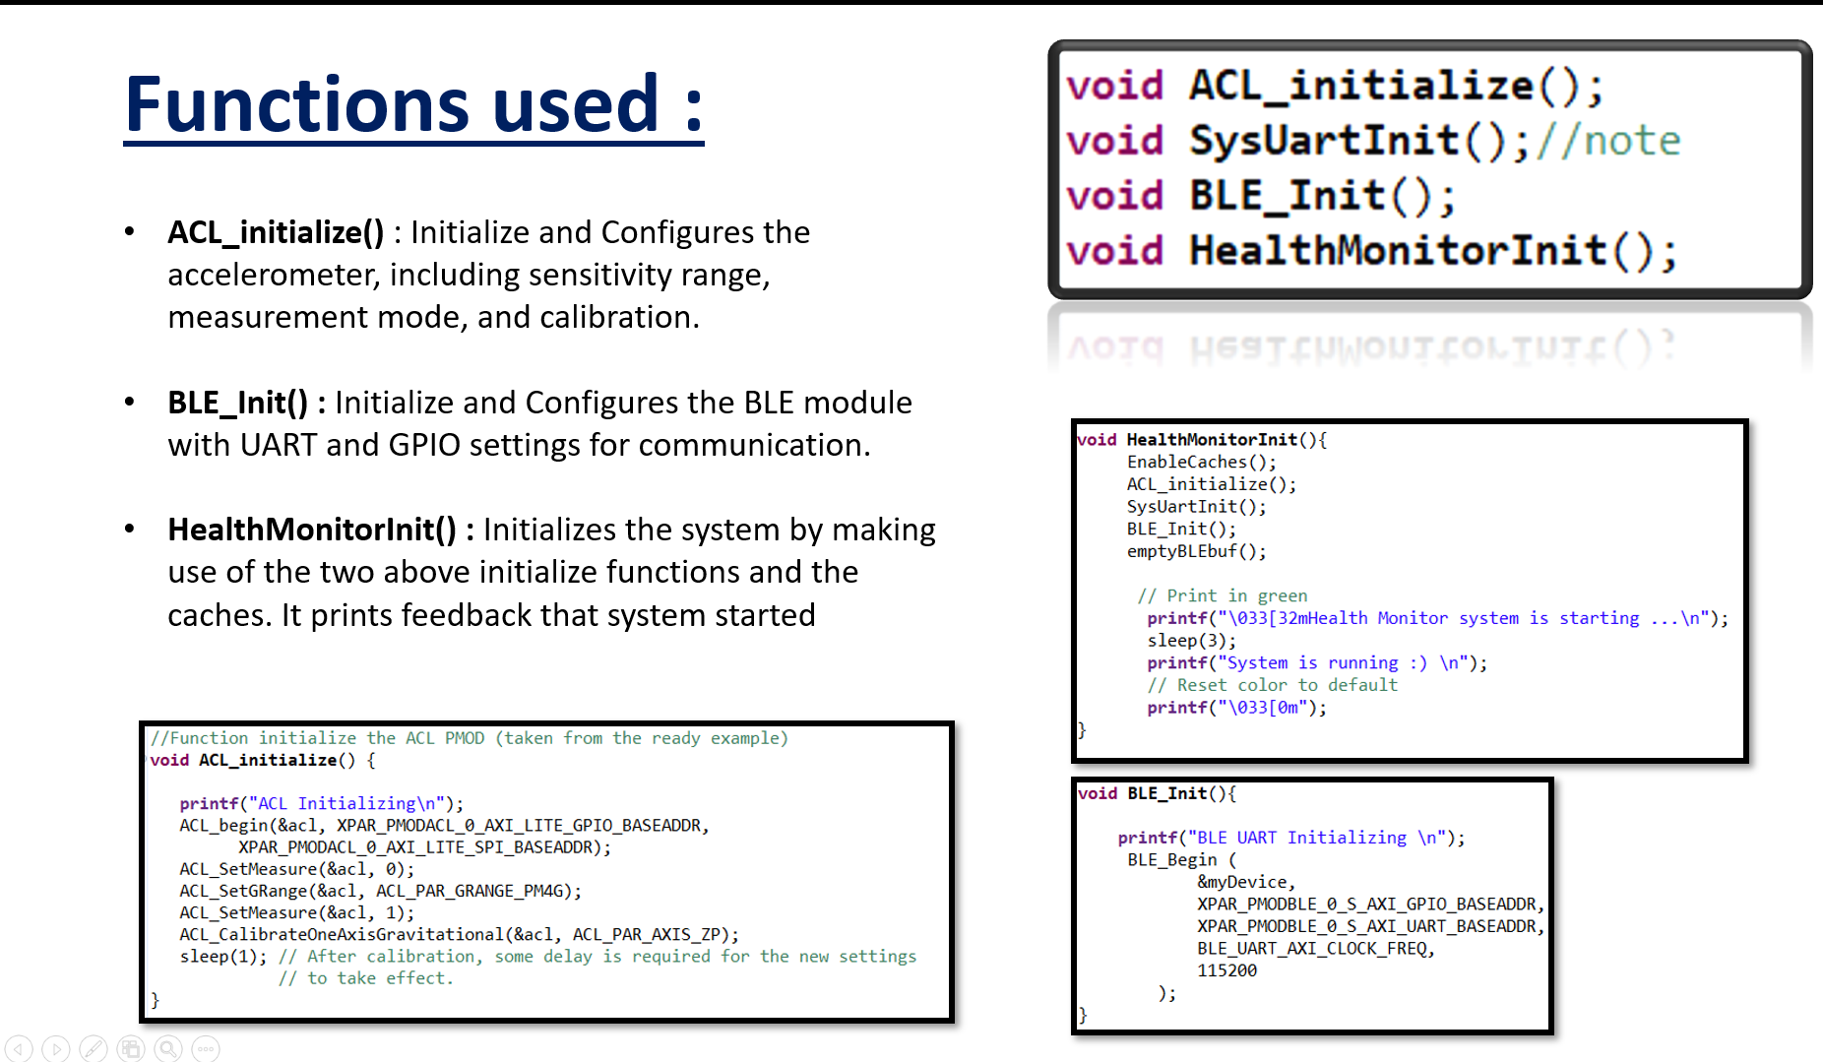
5. Implementation in Vitis

Slide 12
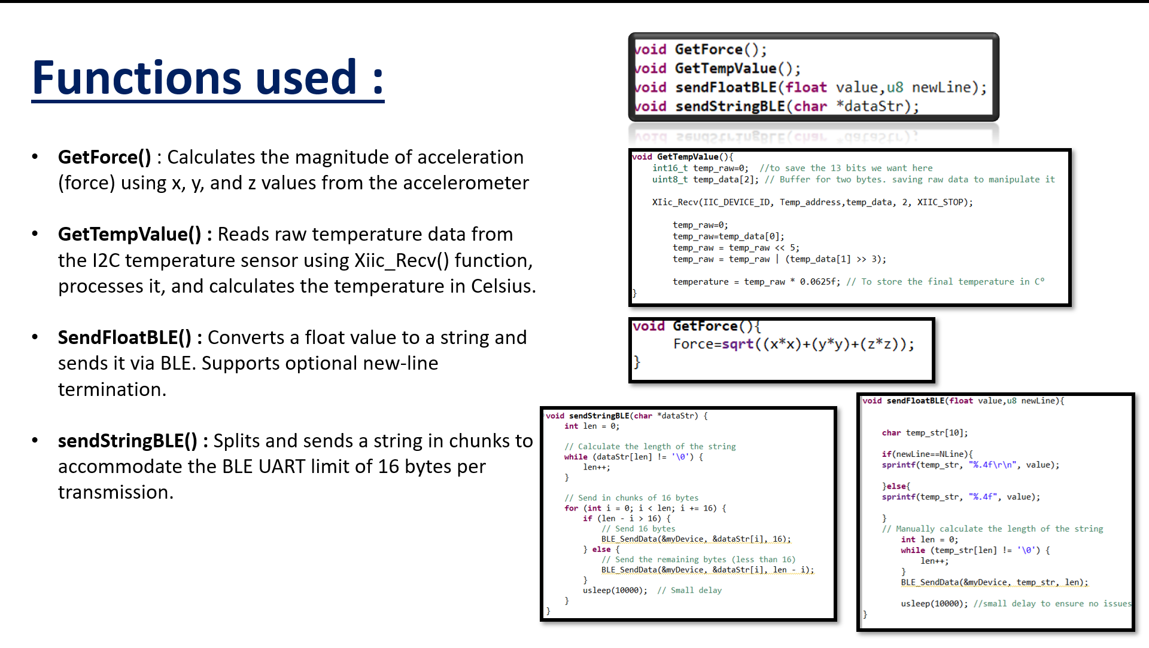
5. Implementation in Vitis

Slide 13
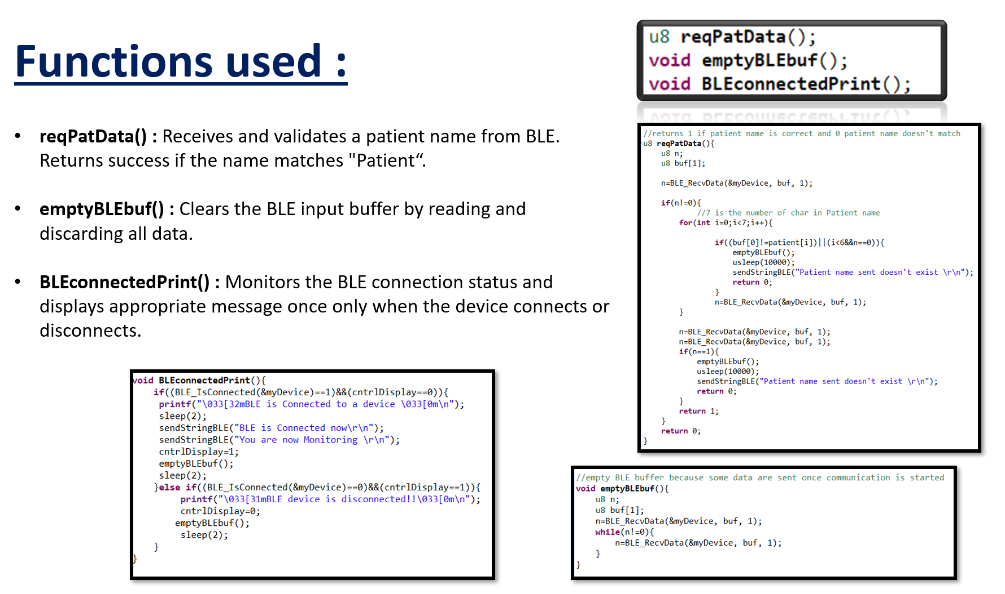
5. Implementation in Vitis

Slide 14
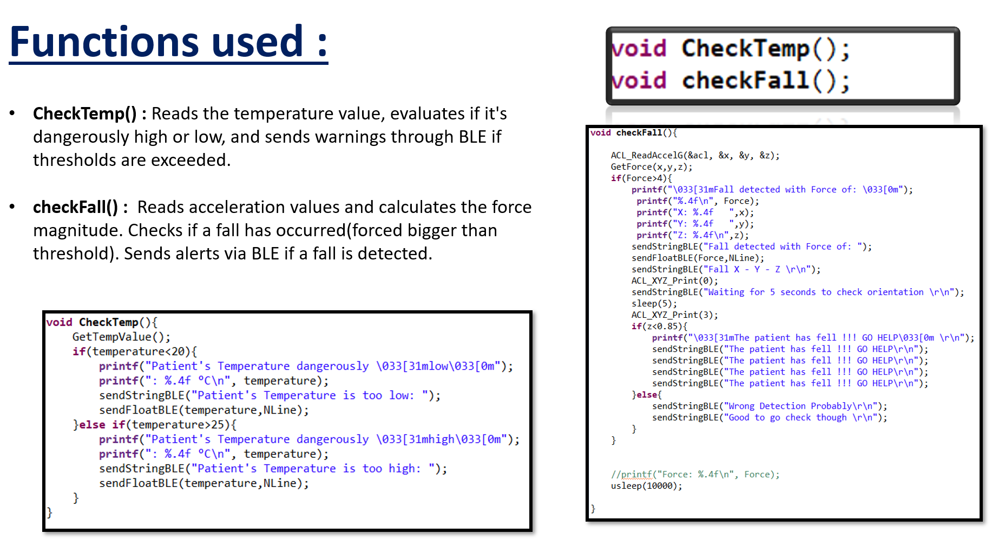
5. Implementation in Vitis

Slide 15
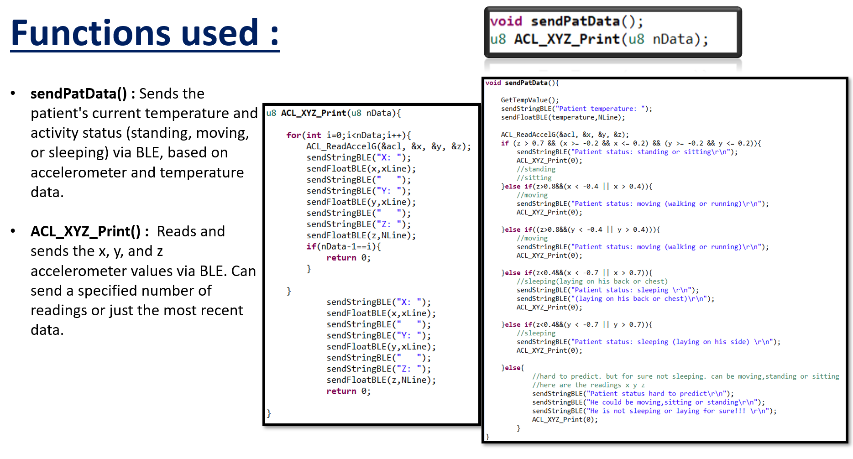
5. Implementation in Vitis

Slide 16
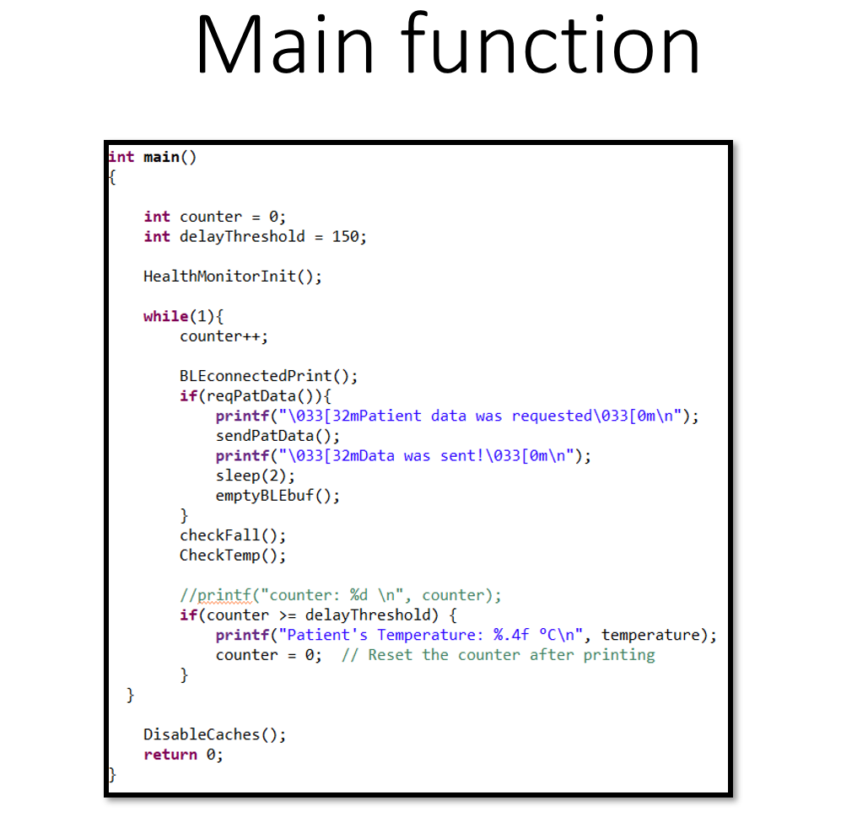
5. Implementation in Vitis

Slide 17
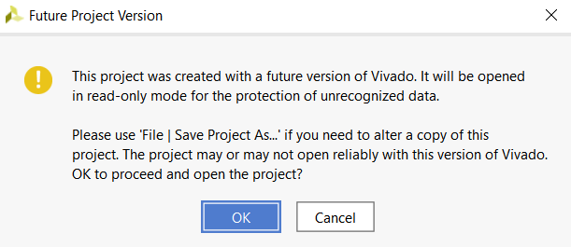
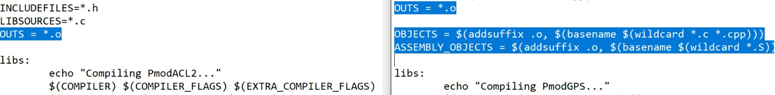
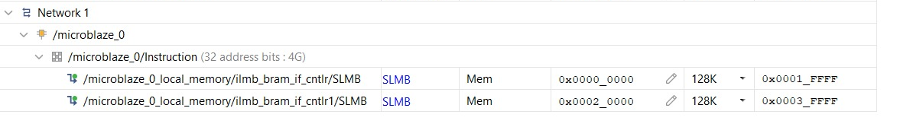
6. Implementation Challenges
Vivado & Vitis versions issue
Make file issues
Memory size issue (BRAM)

Slide 18
7. Conclusion
Real-time Monitoring: High-speed data acquisition and processing.
Scalability: FPGA allows for easy integration of additional sensors.
Reliability: Accurate vital sign tracking with low latency.
User-Friendly: Mobile application for real-time data visualization.

Slide 19
Thank you!

